Slide 1


Exploring the world of Large Language Model (LLM) with KerasNLP
Hrishikesh Yadav

Slide 2

TABLE OF CONTENTS
1
Exploring KerasNLP
2
Understanding LLMs
3
How Does it work
4
Understanding Fine-Tuning
5
Hands On Fine Tuning with KerasNLP

Slide 3
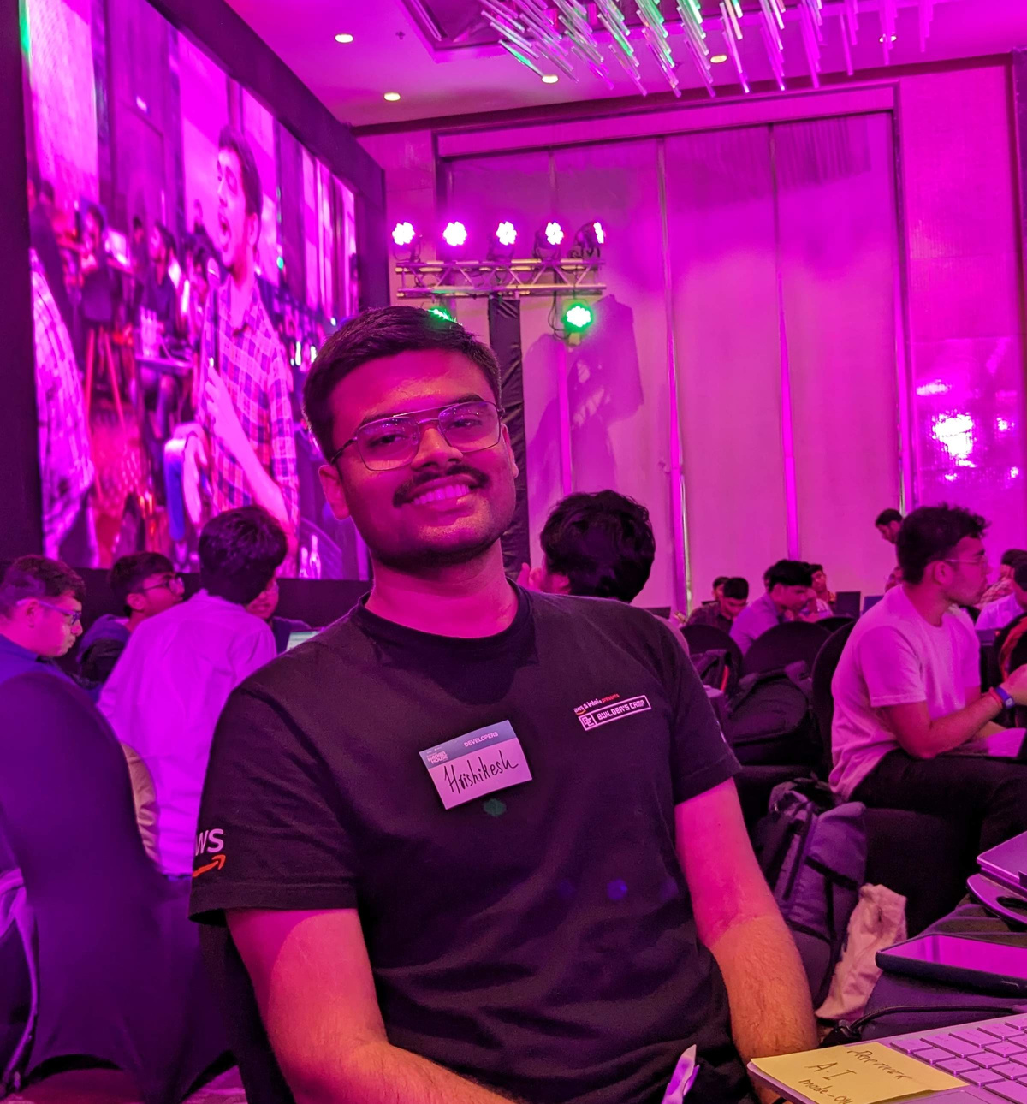
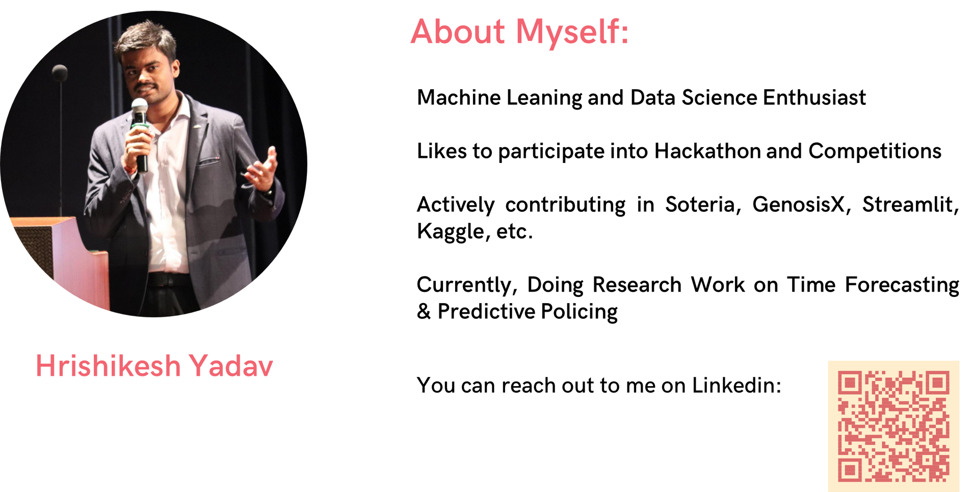

ABOUT
Machine Leaning, Data Science and Applied Generative AI Enthusiast
Likes to participate into Hackathon and Competitions
Actively contributing in Soteria, GenosisX, Streamlit, Kaggle, etc.
Currently, Doing Research Work on Predictive Policing and Applied Generative AI
GDSC TCET VCP 22-23
AI Lead @TCET OpenSource
Community Co-Lead @GenosisX
AI Instructor @RanchoLabs
Student Ambassador @Strealmit

Slide 4

KERAS API PHILOSPHY
Progressive Disclosure of Complexity

Slide 5
WHAT IS KERASNLP
NLP Development Companion
Supports the entire NLP development cycle.
Modular components with preset weights and customizable architectures.

Slide 6
KEYFEATURES OF KERASNLP
Built from modular components.
Offers state-of-the-art preset weights and architectures.
An extension of the core Keras API.
Easily customizable for more control.

Slide 7
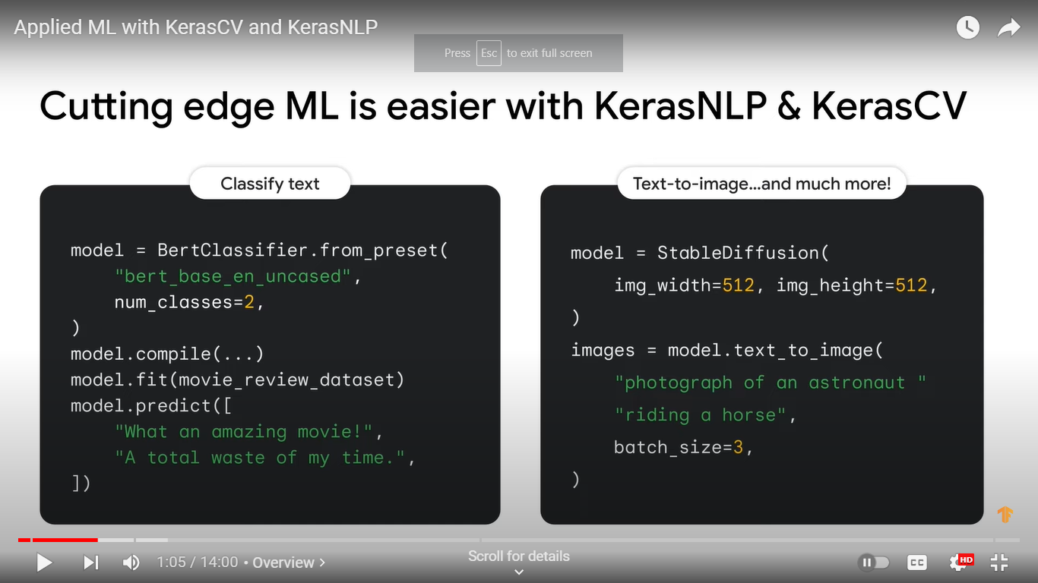
KERASNLP

Slide 8
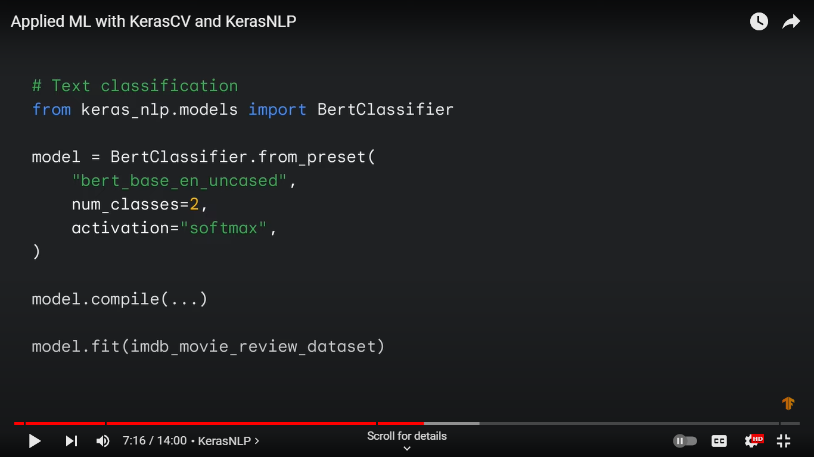
KERASNLP

Slide 9
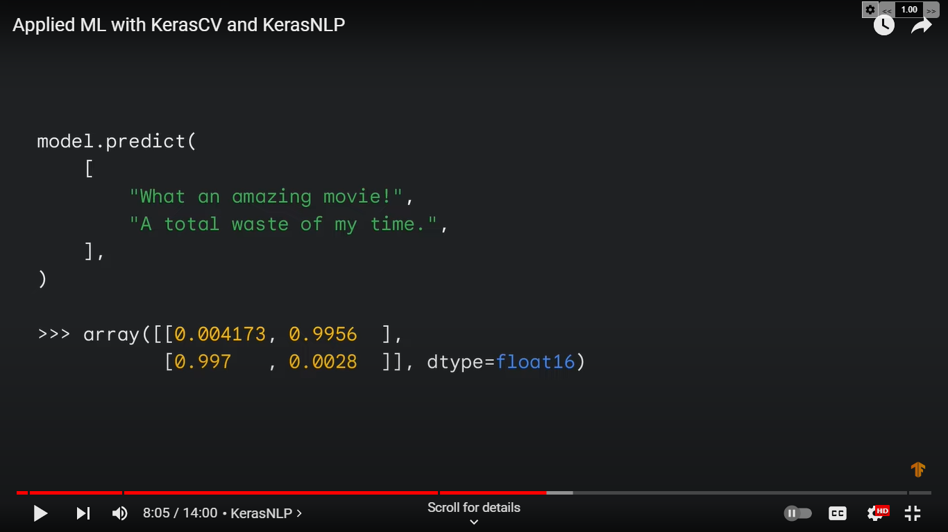
KERASNLP

Slide 10
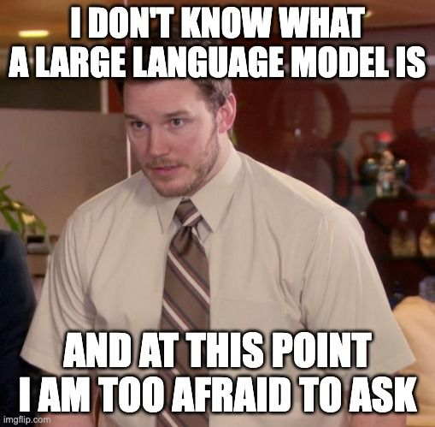
WHAT IS
LLM

Slide 11
WHAT IS
LLM
LLMs are typically trained on datasets large enough to include nearly everything that has been written on the internet.
LLMs can apply their language understanding to tasks they were never explicitly trained.
LLMs are not just for teaching AIs human languages, but for understanding proteins, writing software code, and much more

Slide 12

WHY LLM IS ON BOOM
JAYESH
Changes how we interact with the data
Can find pattern and connections in massive, disparate data corpus

Slide 13
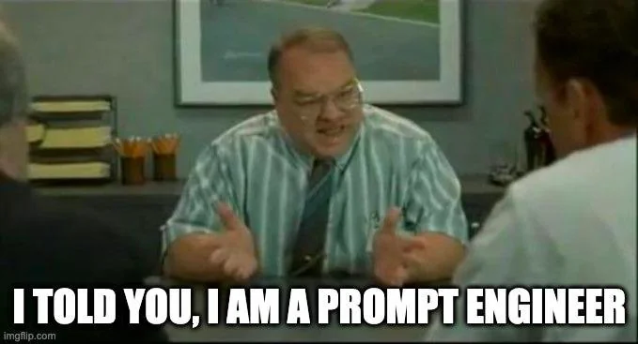
WHY LLM IS ON BOOM
Does not need ML expertise
Does not need to train a model
Need zero training data
Only think about the prompt design

Slide 14
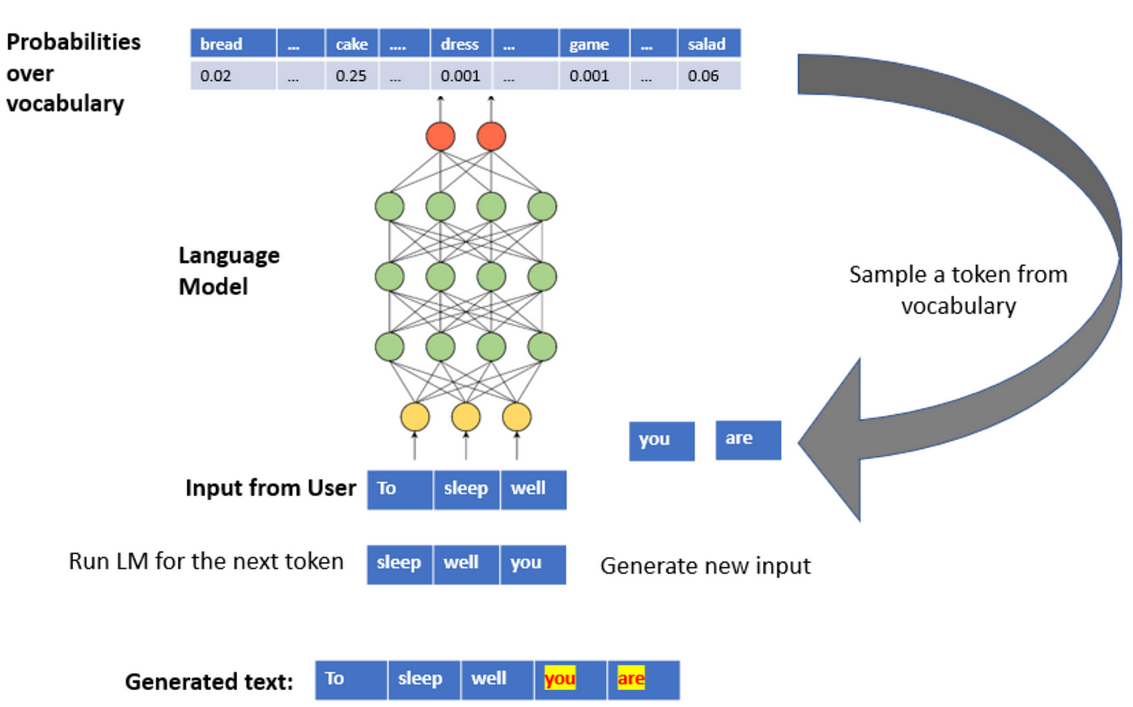
HOW DOES IT WORK
JAYESH

Slide 15
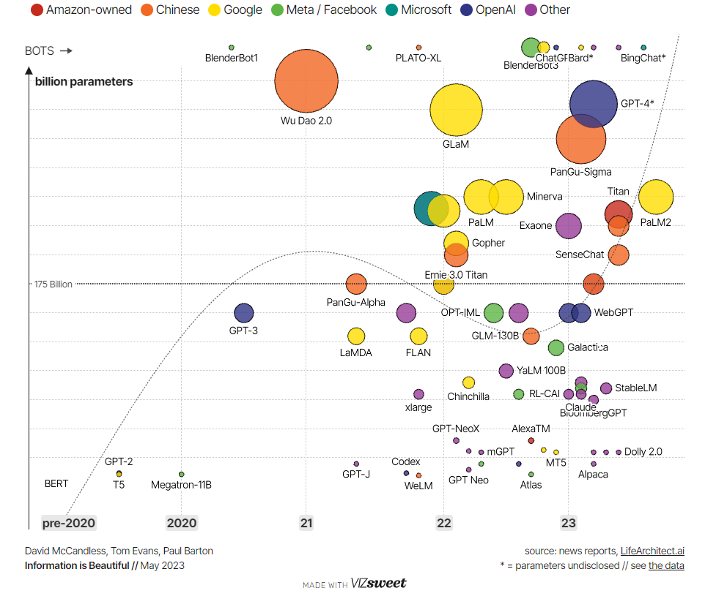
JOURNEY OF
LARGE
LANGUAGE
MODELS

Slide 16




GENERATIVE AI FRAMEWORK

Slide 17
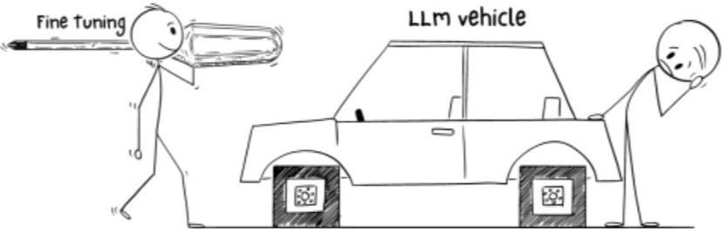
WHY
FINE-TUNING

Slide 18
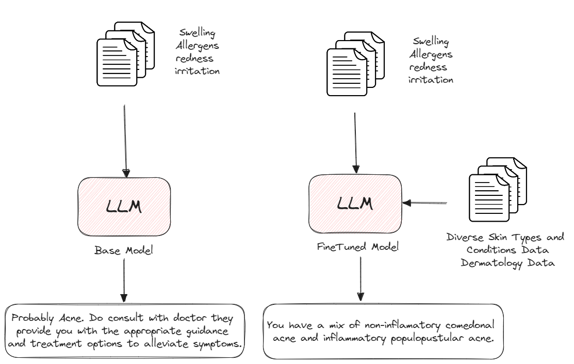
WHY
FINE-TUNING IS NEEDED

Slide 19
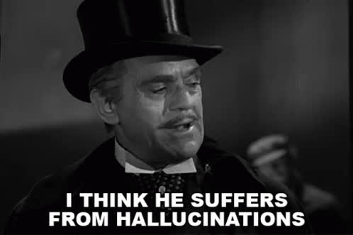
WHY
FINE-TUNING IS NEEDED
Domain Specific
Production Usage
Privacy
Stop Hallucination
Reduce unwanted information
Greater Control
Increase Consistency

Slide 20
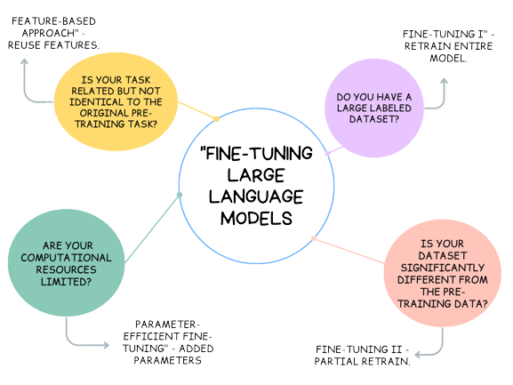
UNDERSTANDING
FINE-TUNING

Slide 21
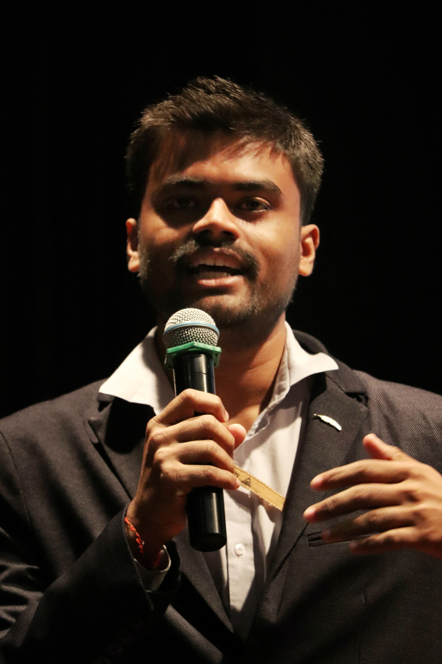
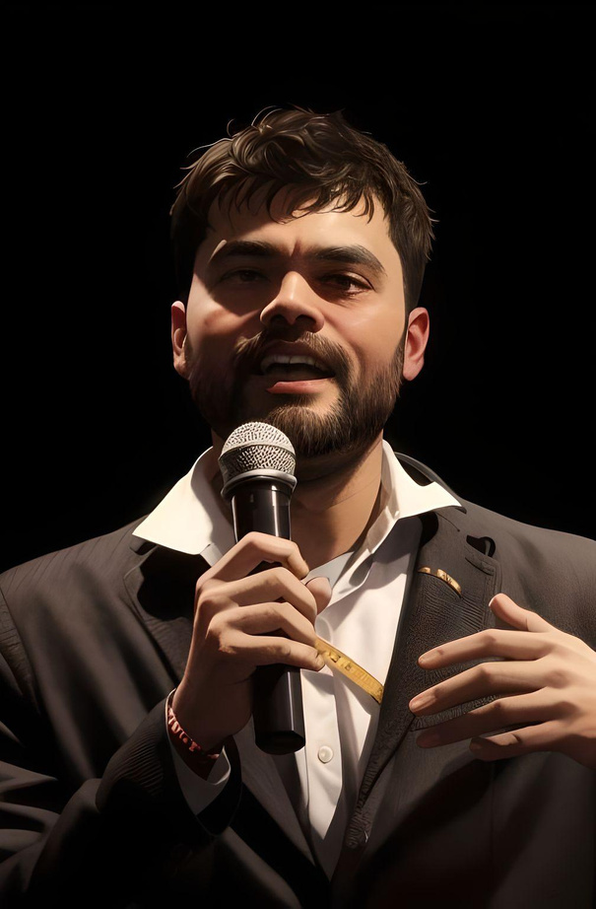

TEMPERATURE TUNING

Slide 22
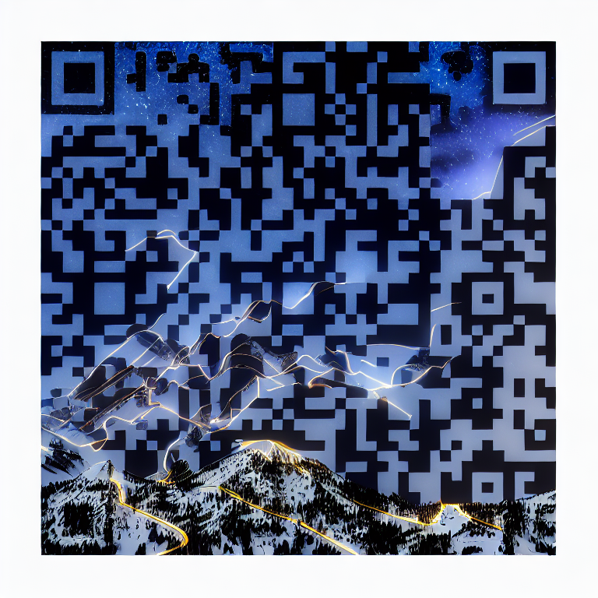

RESOURCES AND HANDS-ON
NOTEBOOK
Scan the QR

Slide 23
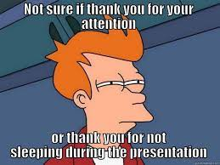

Slide 24
ABOUT
Machine Leaning, Data Science and Applied Generative AI Enthusiast
Likes to participate into Hackathon and Competitions
Actively contributing in Soteria, GenosisX, Streamlit, Kaggle, etc.
Currently, Doing Research Work on Predictive Policing and Applied Generative AI
GDSC TCET VCP 22-23
AI Lead @TCET OpenSource
Community Co-Lead @GenosisX
AI Instructor @RanchoLabs
Student Ambassador @Strealmit

Slide 25
